Slide 1
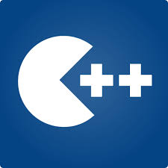
Empowering students with the skills required to lead the way in hi-tech world.

Slide 2
Section 3 Programming with Turtle Graphics
© LaunchPad Learning Inc. All rights reserved.

Slide 3
What We’ll Learn Today
Introduction to Turtle Graphics
Demo of Some Interesting Projects
Draw Geometric Shapes using Turtle
© LaunchPad Learning Inc. All rights reserved.

Slide 4
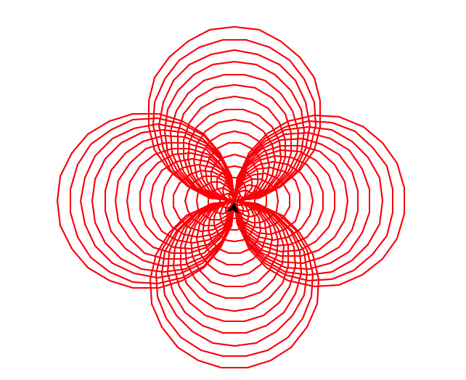
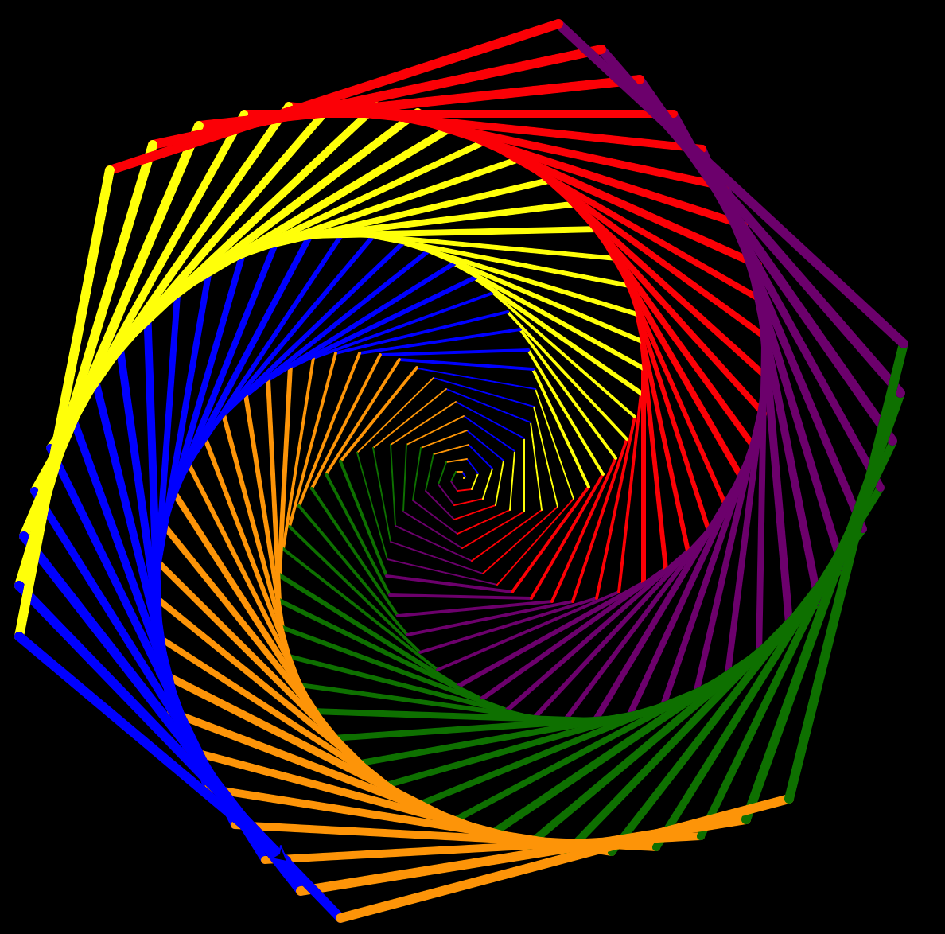
Turtle Graphics
Turtle graphics is a power drawing tool
in python
Part of turtle package in Python
Contains basic commands and
a drawing board on which you move
a turtle to draw various shapes
© LaunchPad Learning Inc. All rights reserved.

Slide 5
Turtle Package
The turtle module needs to be imported at the start of any Python program that uses it: import turtle
Basic Commands
turtle.forward(x)
Moves turtle forward in direction it is facing by x steps
turtle.back(x)
Moves turtle backward from its facing direction by x steps
turtle.left(x)
Turns the turtle x degrees counter-clockwise
turtle.right(x)
Turns the turtle x degrees clockwise
© LaunchPad Learning Inc. All rights reserved.

Slide 6
Demo 1: Game
Download the file Game, Open the file in IDLE, Run the code in IDLE
Use the arrow keys to control the turtle, you have to feed the turtle the black boxes
Every time the turtle is fed, the speed increases
Task:
Slow down the speed of the turtle
Hint: Look for variable speed
© LaunchPad Learning Inc. All rights reserved.

Slide 7
Demo 2: Spiral
Download the file Color Spiral, Open the file in IDLE, Run the code in IDLE
Notice how you can generate beautiful graphics
Task:
Change the graphic to a triangle shape
Hint: Look for variable sides, remember a triangle has 3 sides
© LaunchPad Learning Inc. All rights reserved.

Slide 8
Demo 3: Square
Download the file Square, Open the file in IDLE, Run the code in IDLE
Notice that a square is being generated
We already know what every command does
Now change the code to make a rectangle
Hint: Remember that a rectangle has a length and a breadth
Change the code to make a red colored rectangle
© LaunchPad Learning Inc. All rights reserved.

Slide 9
HomeWork
Download the file Homework from Weebly
I forgot to finish the code, can you please finish it. I want the code to make a triangle for me
I also forgot to add color to my triangle, can you please change the line color to red.
Bonus:
Can you now make a hexagon (6 sides) and an octagon (8 sides)?
© LaunchPad Learning Inc. All rights reserved.

Slide 10
That’s it for today
Homeworks have been posted on the Weebly. For any questions contact your teacher.
Thank You !!!!
© LaunchPad Learning Inc. All rights reserved.

